Slide 1
Introduction to Simulation and Modeling

Slide 2
Advanced Project Management Concepts
(Lecture 11,12)

Slide 3
Advanced Project Management Concepts
We briefly review the critical path method (CPM) and program evaluation and review technique (PERT).
PERT and CPM were both developed in the 1950s as project management tools.
The primary difference between PERT and CPM lies in their abilities to handle randomness in managing project tasks.
CPM focuses on project task durations that are deterministic or, in other words, do not vary in time.
Conversely, PERT was specifically designed to handle variations in project task durations.
Fifty years later, the distinction between PERT and CPM has blurred, and sometimes these techniques are referred to as PERT/ CPM.

Slide 4
Advanced Project Management Concepts
we refer to these techniques as networks. To describe the project in network terminology, we have:
Activities
Events
Nodes
Arcs
Paths
Critical path

Slide 5
Advanced Project Management Concepts
An activity is a task that requires time to complete.
An event is defined as the completion of one or more activities at a particular time.
A project is represented by a network consisting of nodes and arcs.
The nodes in the network are connected by one or more arcs.
The arc arrow represents the required sequence of the activities.
A path is a sequence of nodes and arcs.
The critical path is the path that, if delayed, results in an increase in the overall project time.

Slide 6
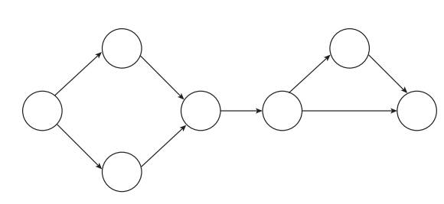
Advanced Project Management Concepts

Slide 7
Advanced Project Management Concepts
The actual representation of the project with respect to the nodes and arcs can take two different forms:
1. Activity on node (AON)
2. Activity on arc (AOA)

Slide 8
Activity on node (AON)
project activities are represented by the nodes on the network.
we start at the leftmost node.
From the start node, two arcs are possible.
There is an arc to node 1 and there is an arc to node 2. This means that there is no precedence relationship between the activities represented by nodes 1 and 2.
There is also a single arc leaving node 1 and a single arc leaving node 2. Both of these arcs lead to node 3.
This representation means that in order to begin the activity represented by node 3, both the activities represented by node 1 and node 2 must first be completed.

Slide 9
Activity on node (AON)
Once the activity at node 3 is complete, there is one arc that leads to node 4.
The activity on node 4 can begin only when the activity represented by node 3 is completed.
When the activity on node 4 is completed, there are two different arcs.
One arc leads directly to the finish, and the other arc leads to node 5.
Before either of these activities can be conducted, the activity on node 4 must be completed.
There is a single arc from node 5 that also leads to the finish node.
This means that in order to finish the network, both the activity of node 4 and the activity of node 5 must first be completed.

Slide 10
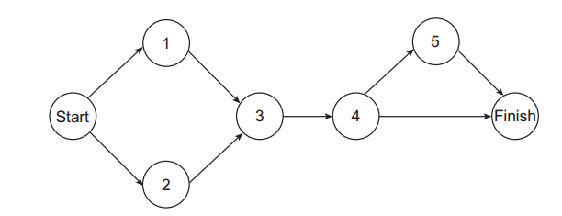
Activity on node (AON)

Slide 11
. Activity on arc (AOA)
The activity-on-arc (AOA) project representation utilizes nodes to represent finished events and arcs to represent activities.
we start at event node 1. At node 1 two different activity arcs lead to event nodes 2 and 3.
Arc A leads between node 1 and node 2. Arc B leads between node 1 and node 3. This means that both of these activities can be performed at the same time.
The next node is node 4. A single arc, C, leads from node 2 to node 4. Another single arc, D, leads from node 3 to node 4. This means that both activity arc C and activity arc D must be completed in order to reach event node 4.

Slide 12
. Activity on arc (AOA)
Once at event node 4, there is activity arc E to event node 5.
At event node 5 there are activity arcs F to node 6 and G to the finish node.
Arc F and arc G can be performed at the same time. At event node 6, there is a final activity arc, H, to the finish event.
Before the finish event can be reached, both activity arcs G and H must be complete.

Slide 13
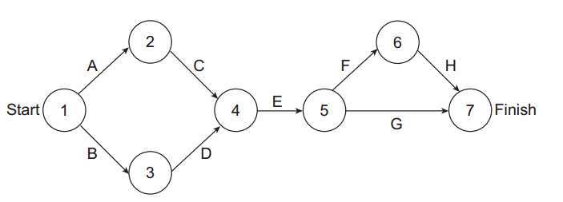
. Activity on arc (AOA)

Slide 14
. Activity on arc (dummy activity)
it is sometimes necessary to insert a dummy activity.
This is an activity that actually has no duration and uses no resources.
Its sole purpose is to provide a logical connection between two nodes.
Dummy activities are typically represented by a dashed-line arc.
Suppose, in the previous example, both activites A and B are needed for event 3. In this case, the original activity arc B still exists, but there is a new dummy activity arc with no label between
event node 2 and 3.

Slide 15
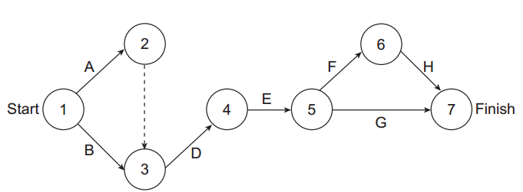
. Activity on arc (dummy activity)

Slide 16
Simulation Project Network Example

Slide 17
Simulation Project Network Example
We use the AOA approach to illustrate one possible network for part of a simulation project
In this network, the arcs correspond to the following first-level project tasks:
A = Problem statement
B = Project planning
C = System definition
D = Input data
E = Model translation
F = Verification
G = Validation
H = Experimental design
I = Analysis
J = Conclusions

Slide 18
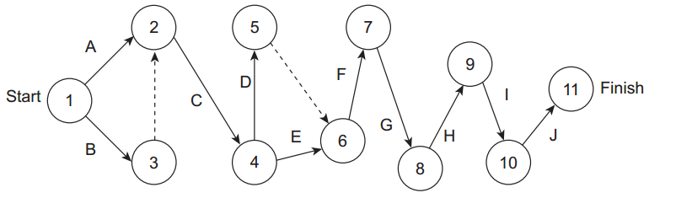
Simulation Project Network Example

Slide 19
Simulation Project Network Example
This network is only one of many ways that the simulation project might have been represented.
Depending on practitioner’s willingness to compress some tasks, it would be possible to develop a more complicated network.

Slide 20
Calculating the Critical Path
Once we have developed our AOA network and have estimated the duration of each activity arc in the network,
we can consider calculating the critical path through the network.
To compute the critical path, we will need to calculate the following values for each activity in the network:
ES = Earliest start time
EF = Earliest finish time
LS = Latest starting time
LF = Latest finish time

Slide 21
Calculating the Critical Path
For each of the activities in the network, we can easily calculate the earliest finish time as:
EF = ES + task duration
Similarly, the latest start time for each of the activities in the network can be calculated with the following equation:
LS = LF – task duration
In general, we make a forward pass and a backward pass to calculate all of theses values and eventually obtain the critical path.

Slide 22
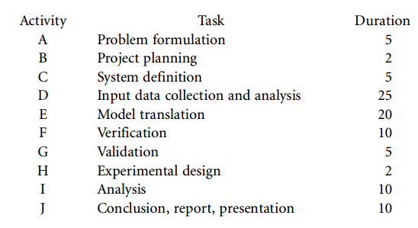
Calculating the Critical Path

Slide 23
Calculating the Critical Path
We now begin our calculations with a chart with the following headings:
Activity
Duration
Predecessor
ES
EF

Slide 24
Calculating the Critical Path
We begin by listing the data for activities A and B.
As the network chart indicated, both of these activities do not have any predecessors.
Because neither of these activities has a predecessor, the earliest start date is time 0.
The earliest finish times for each activity are the same as the duration of the activities

Slide 25
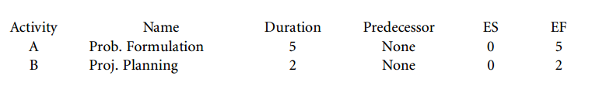
Calculating the Critical Path

Slide 26
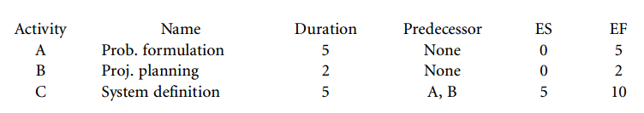
Calculating the Critical Path
The next activity is C, System Definition. This activity has both activity A, Problem Formulation, and activity B, Project Planning, as predecessors. This means that the earliest start for activity C, System Definition, is the later of activities A and B. Because activity A has the earliest finish of 5, the earliest start for activity C is 5. The earliest finish for the System Definition is the earliest start plus the duration of the activity. Thus, the earliest finish is 10 days

Slide 27
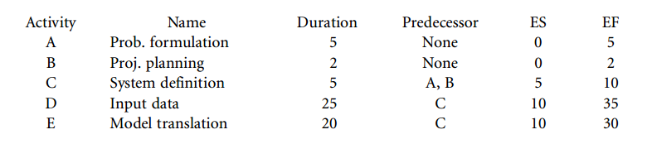
Calculating the Critical Path
Activities D, Input Data Collection and Analysis, and E, Model Translation, both have activity C, System Definition, as a predecessor.

Slide 28
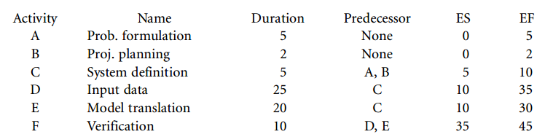
Calculating the Critical Path
Activity F, Verification, requires that both activity D, Input Data Collection and Analysis, and activity E,
Model Translation, be complete. Because the later of these two activities is 35 days, activity F, Verification, cannot begin until the end of activity D, Input Data Collection and Analysis.

Slide 29
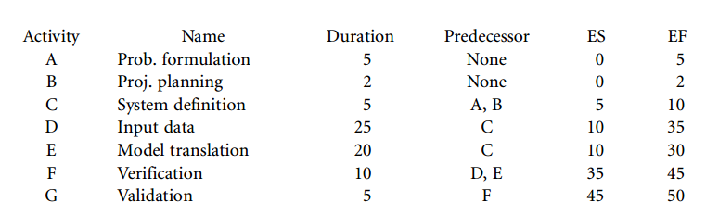
Calculating the Critical Path
Activity G, Validation, has activity F, Verification, as a predecessor. Since activity F, Verification, does not
end until 45, the earliest start date for activity G, Validation, is 45. The duration of activity G is 5 days, so the earliest finish date is 50 days.

Slide 30
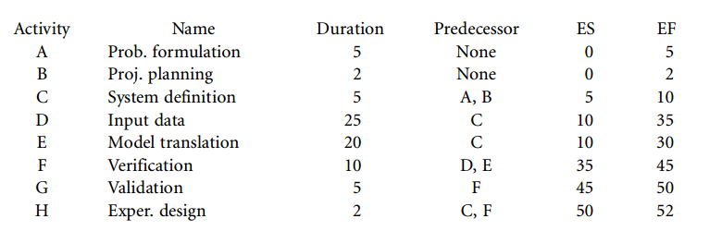
Calculating the Critical Path
Activity H, Experimental Design, has activity G, Validation, as a predecessor.

Slide 31
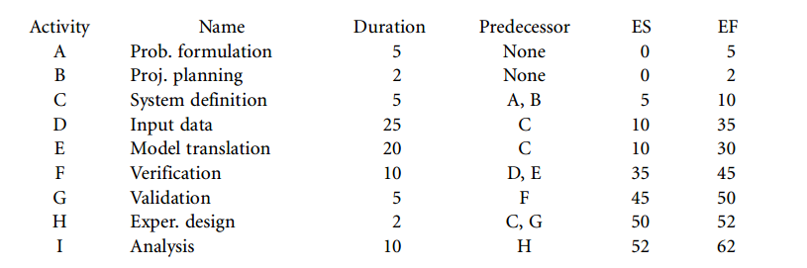
Calculating the Critical Path
Activity I, Analysis, has activity H, Experimental Design, as a predecessor.

Slide 32
Calculating the Critical Path
Last, Activity J, Report and Presentation, has activity I, Analysis, as a predecessor.
Because the earliest finish time for activity I, Analysis, is 62, the earliest start date for activity J, Report and Presentation, is 62.
The duration of activity J is 10 days, so the earliest finish date for activity J, Report and Presentation, is 72 days.

Slide 33
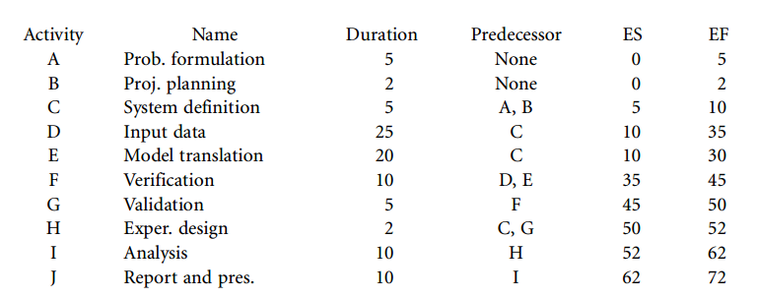
Calculating the Critical Path

Slide 34
Calculating the Critical Path
We begin by listing the data for activities A and B.
As the network chart indicated, both of these activities do not have any predecessors.
Because neither of these activities has a predecessor, the earliest start date is time 0.
The earliest finish times for each activity are the same as the duration of the activities

Slide 35
Calculating the Critical Path (backward pass)
The minimum amount of time that this particular project can be completed in is a total of 72 days.
Once we have determined the length of the critical path,
we can perform our backward pass.
We can now add the latest start and the latest finish columns to our table.
We begin the backward pass by fixing the latest finish value of activity J at 72 days.
Because activity J, Report and Presentation, is 10 days in duration, the latest start for activity J is 62 days.
From this point on, the latest finish date for each remaining task is generally going to be the earliest of all of the latest start dates of its successors.

Slide 36
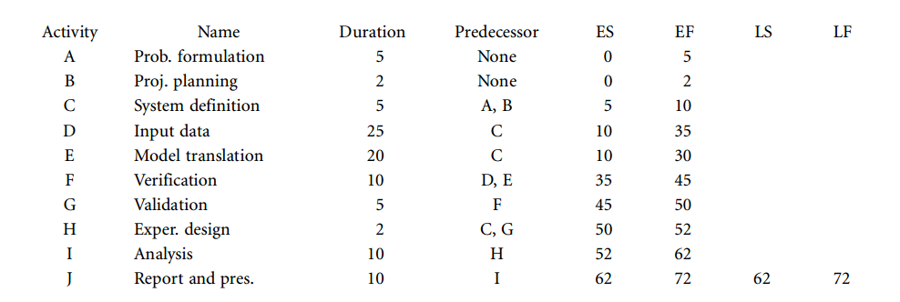
Calculating the Critical Path (backward pass)

Slide 37
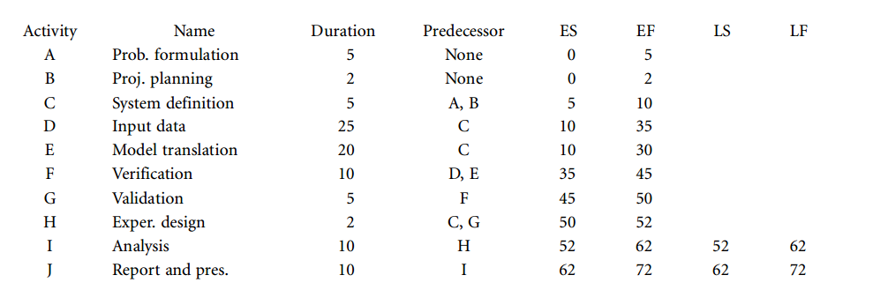
Calculating the Critical Path (backward pass)
The only successor to activity I, Analysis, is activity J, Report and Presentation. Because the latest start date of activity J is 62, the latest finish date of activity I, Analysis, is 62. The latest start date of activity I, Analysis, is 52 days.

Slide 38
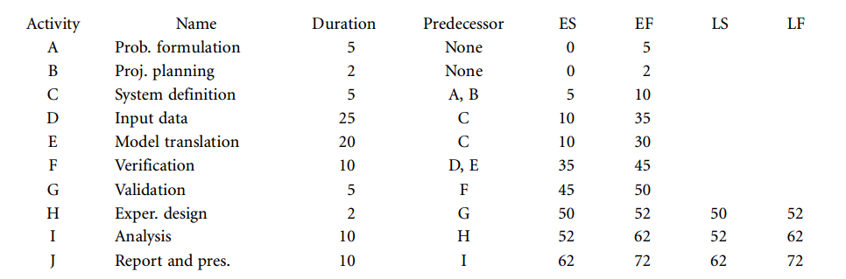
Calculating the Critical Path (backward pass)
Activity H, Experimental Design, has only one successor.

Slide 39
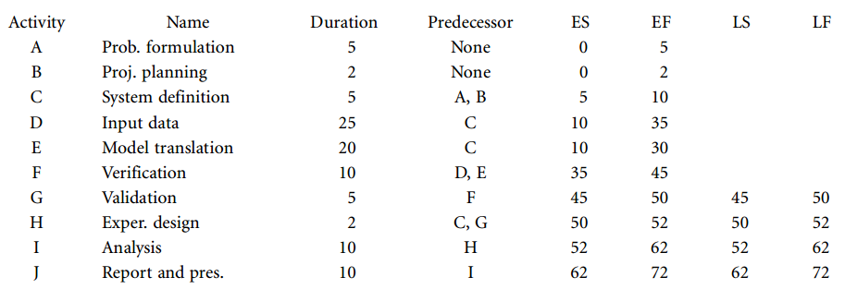
Calculating the Critical Path (backward pass)
Activity G, Validation, has one successor, activity H, Experimental Design.

Slide 40
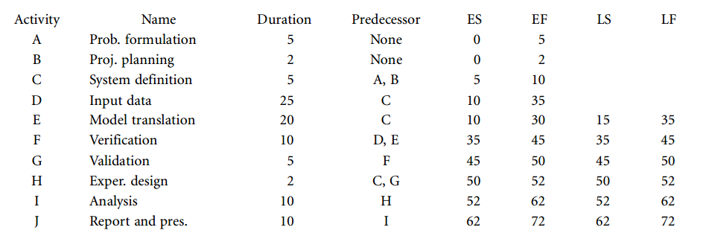
Calculating the Critical Path (backward pass)
The only successor to activity F, Verification, is activity G, Validation
Activity E, Model Translation, has only activity F, Verification, as a successor.

Slide 41
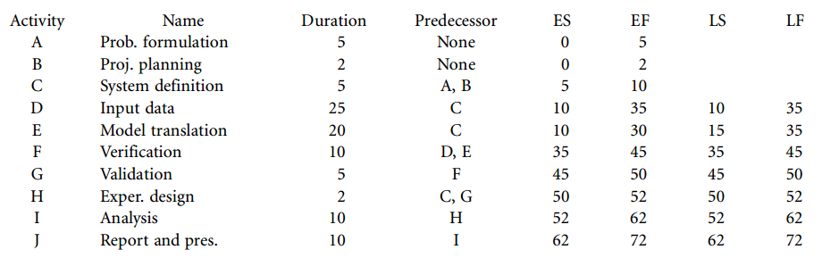
Calculating the Critical Path (backward pass)
Activity D, Input Data Collection and Analysis, has only one successor. This is activity F, Verification

Slide 42
Calculating the Critical Path (backward pass)
The latest start and latest finish times for activity C, System Definition, are somewhat more complicated to determine than the previous activities.
Activity C actually has two successors. The first successor is activity D, Data Collection and Analysis.
The second successor is activity E, Model Translation.
The latest start time for activity D is 10, and the latest start time for activity E is 15.
Because we need the earliest of the latest start times, the latest finish time for activity C, System Definition, becomes 10 days.
Because the duration of activity C is 5 days, the latest start date is 5 days

Slide 43
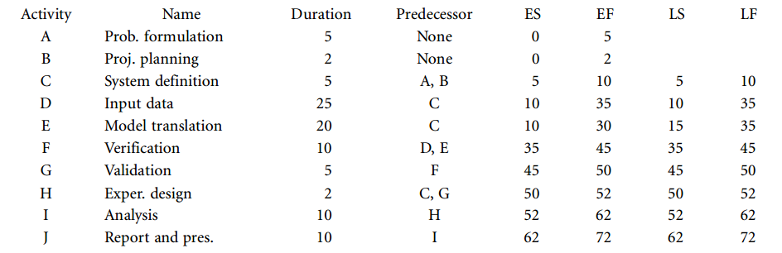
Calculating the Critical Path (backward pass)

Slide 44
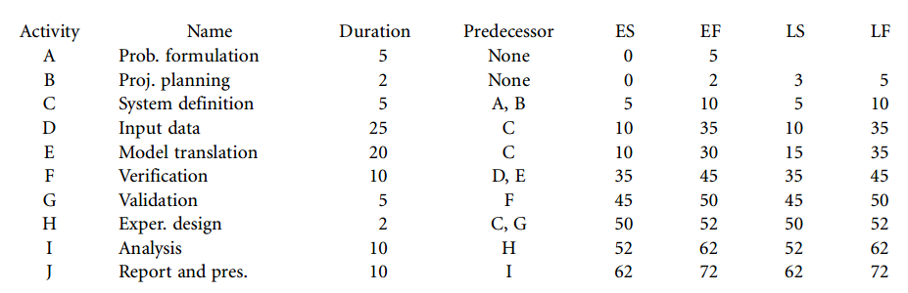
Calculating the Critical Path (backward pass)
Activity B, Project Planning, has only one successor, activity C, System Definition.

Slide 45
Calculating the Critical Path (backward pass)
Activity B, Project Planning, has only one successor, activity C, System Definition.
The final activity, activity A, Problem Formulation, has only one successor.
This is activity C, System Definition.
The latest start date of activity C, System Definition, is 5 days.
This means that the latest finish date for activity A is also 5 days. Because activity A is 5 days in duration, the latest start date is 0 days

Slide 46
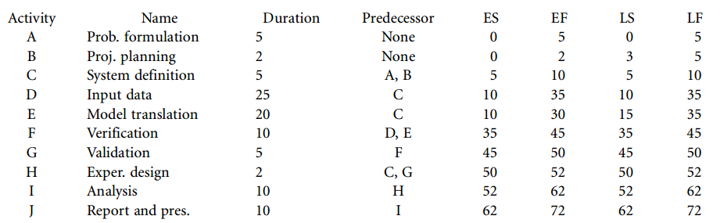
Calculating the Critical Path (backward pass)

Slide 47
Calculating the Critical Path (Slack)
The backward pass is complete.
We can now calculate what is known as the slack for each activity.
This is the difference between the latest start and the earliest start.
It is also the difference between the latest finish and the latest start.
The slack is listed in an additional column in our table.

Slide 48
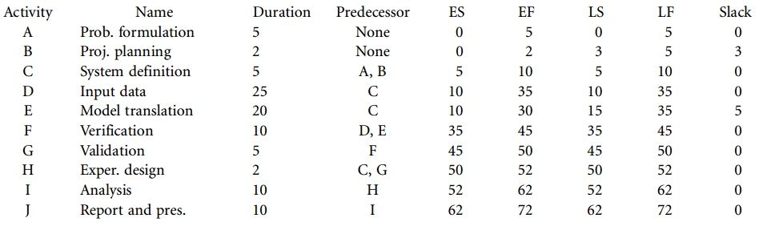
Calculating the Critical Path (Slack)

Slide 49
Calculating the Critical Path
The critical path can be identified by the activities with 0-day values in the slack column. This means that the critical path is:
Activity A – Problem formulation
• Activity C – System definition
• Activity D – Input data collection and analysis
• Activity F – Verification
• Activity G – Validation
• Activity H – Experimental design
• Activity I – Analysis
• Activity J – Report and presentation

Slide 50
Calculating the Critical Path
If any of the above critical path tasks exceeds the estimated activity duration, the duration of the whole project will be extended.
Conversely, any of the noncritical task durations can be extended by the slack time without extending the overall length of the project.
If any of the noncritical tasks do exceed slack time, then these tasks become critical.
These previously noncritical tasks that have become critical can now extend the project if their activity times are extended.

Slide 51
Note
The critical path calculated for this particular simulation project example will differ from that for any other simulation project if the precedence of activities or the duration of the activities is changed.
If the practitioner decides to utilize this sort of network technique, a different network and activity table will have to be generated.
The critical path for this new network will also have to be resolved.

Slide 52
Summary
Any Questions?

